Slide 1

Introduction to Operating Systems CS/COE 1550
Fall 2021
Sherif Khattab
ksm73@pitt.edu
(Some slides are from Silberschatz, Galvin and Gagne ©2013)

Slide 2
Announcements
Homework 1 is due this Friday at 11:59 pm
Recitations started last week
Please watch the videos
Lab 1 is due on 9/20 at 11:59 pm
Using GitHub Classroom
Explained in this week’s recitation
Steps of a Syscall in detail on Canvas
TA Office hours available on the syllabus page

Slide 3
What happens on a syscall?
System call invocation is very expensive!
Don’t make unnecessary syscalls in your applications.
2
1
7
6
12
1
eax <-- 1
10
3
int 64
5
4
11
8
9

Slide 4
Muddiest Points (1/2)
Does each syscall and/or interrupt essentially cause a context switch? Also the code at the end was a bit confusing, is main.c what cpu begins executing on boot up?
How and why do we pass parameters to the OS
Are the functions in the hardware picture all pointed to by the IDT or are there other functions in there (like one for each syscall) & also Syscall Parameter Passing
The IDT initialization is a bit weird.
Are all interrupts syscalls but not all syscalls are interrupts?
So is a syscall just like an interrupt, except with more possible functions to chose from?
IDT is a little confusing, does it work similar to the syscall table, but with all interrupts?
Adding new syscalls
Why are f8() and f9() able to add a syscall?

Slide 5
Muddiest Points (2/2)
What is the kernal mode actually used for? As in, what is its purpose as opposed to keeping the CPU in one mode
Can you go over what trap does again?
Since interrupts are electric signals, is it possible to overload/harm a CPU with too many interrupts? Also, what makes one CPU more powerful than an another: is it related to the amount of interrupts it can handle or how many cores it has?
is it easy for virus to gain access to kernel mode?
Can you only have as many system calls as the idt can store?
Are there any differences in speed between software and hardware interrupts?
Why does the idt increase the number of memory accesses for a syscall by pointing to a function that calls the syscall, instead of pointing directly to the syscall? i.e. why isn't the syscall table just a section in the idt?
Is the interrupt # always the same regardless of which piece of hardware?
The atomic part or the differences of interrupts that can be interrupted
How a boot virus works
What is the biggest difference between the System Call table and the IDT? They both provide addresses for interrupt service routines?
I'm curious why you would want to add a new syscall and if there is a limit to the amount of these that could be added

Slide 6
Xv6 Code Walkthrough
IDT table initialization
Syscall table
How a syscall is invoked
Syscall implementation
Parameter passing into a syscall
In Lab 1 you will add a system call to Xv6

Slide 7
Operating System Structure
General-purpose OS is very large program
Various ways to structure an OS:
Simple structure – MS-DOS
More complex – UNIX
Layered – an abstraction
Microkernel – Mach

Slide 8
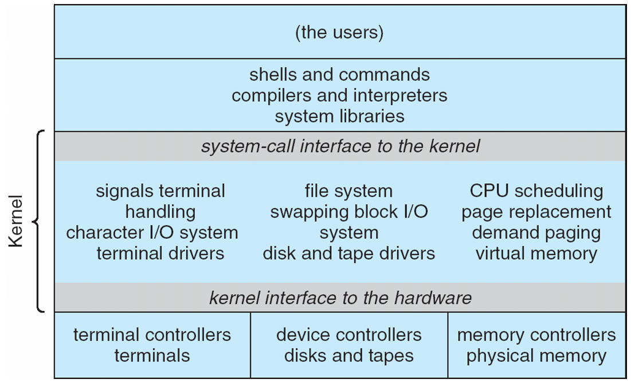
Traditional UNIX System Structure
Beyond simple but not fully layered

Slide 9
Microkernel System Structure

Slide 10
Process Concept
An operating system executes a variety of programs:
Batch system – jobs
Time-shared systems – user programs or tasks
Process – a program in execution; process execution must progress in sequential fashion
Multiple parts
The program code, also called text section
Current activity including program counter, processor registers
Stack containing temporary data
Function parameters, return addresses, local variables
Data section containing global variables
Heap containing memory dynamically allocated during run time

Slide 11
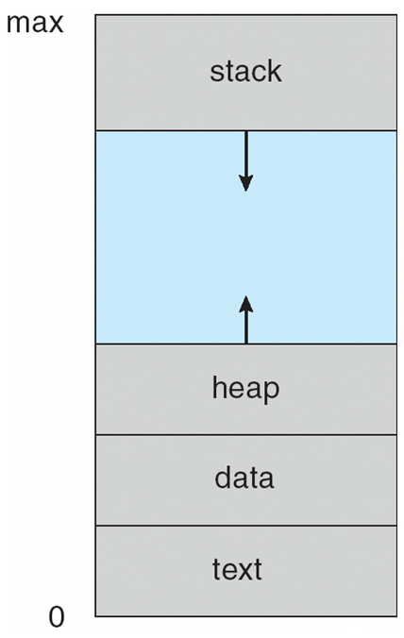
Process in Memory

Slide 12
Process State
As a process executes, it changes state
new: The process is being created
running: Instructions are being executed
waiting: The process is waiting for some event to occur
ready: The process is waiting to be assigned to a processor
terminated: The process has finished execution

Slide 13
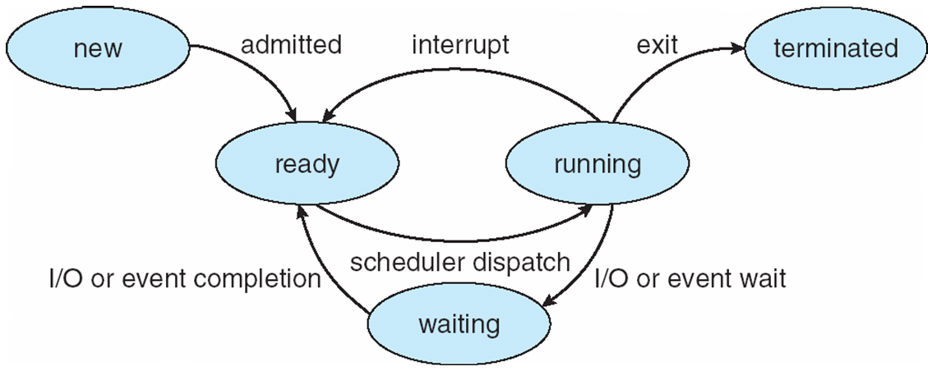
Diagram of Process State

Slide 14
Process Control Block
``Active entities are data structures when viewed from a lower level.’’
Raphael Finkel, University of Kentucky

Slide 15
Process Control Block (PCB)
Information associated with each process
(also called task control block)
Process state – running, waiting, etc
Program counter – location of instruction to execute next
CPU registers – contents of all process-centric registers
CPU scheduling information- priorities, scheduling queue pointers
Memory-management information – memory allocated to the process
Accounting information – CPU used, clock time elapsed since start, time limits
I/O status information – I/O devices allocated to process, list of open files

Slide 16
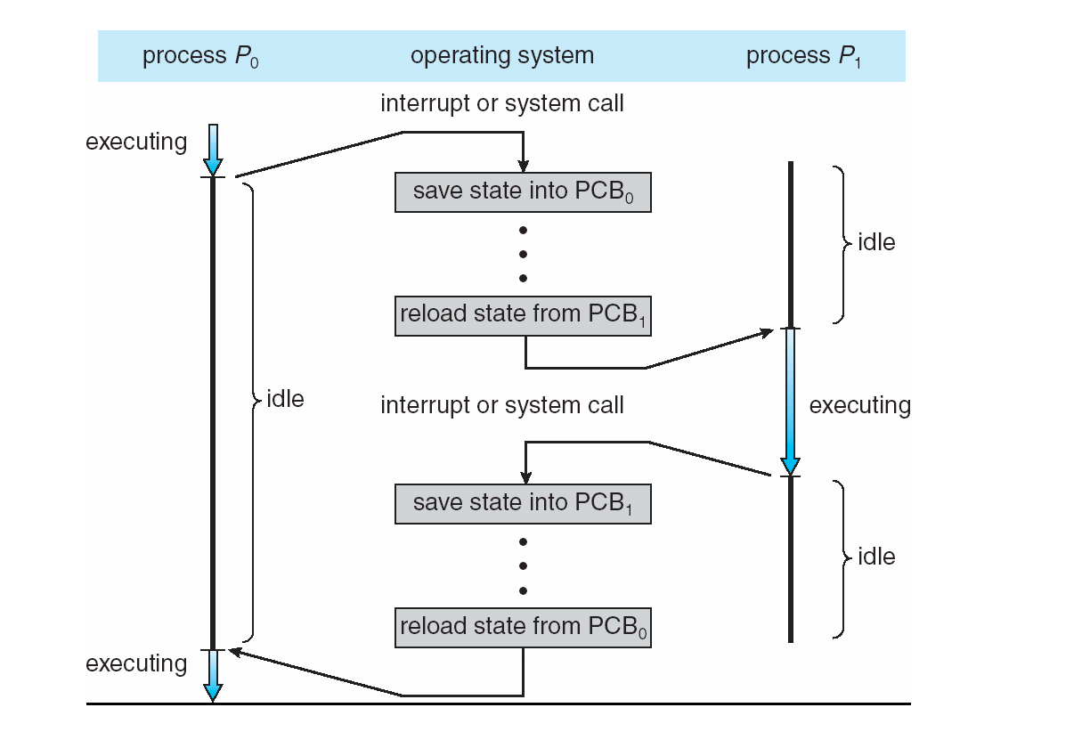
Context Switching

Slide 17
Context Switch
When CPU switches to another process, the system must save the state of the old process and load the saved state for the new process via a context switch
Context of a process represented in the PCB
Context-switch time is overhead; the system does no useful work while switching
The more complex the OS and the PCB ➔ the longer the context switch
Time dependent on hardware support
Some hardware provides multiple sets of registers per CPU ➔ multiple contexts loaded at once

Slide 18
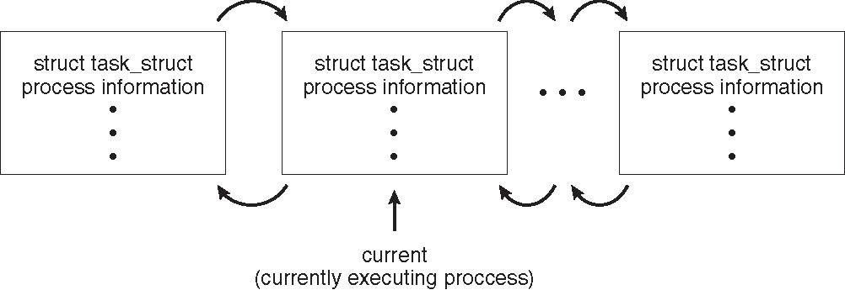
Process Representation in Linux
Represented by the C structure task_struct
pid t_pid; /* process identifier */ long state; /* state of the process */ unsigned int time_slice /* scheduling information */ struct task_struct *parent; /* this process’s parent */ struct list_head children; /* this process’s children */ struct files_struct *files; /* list of open files */ struct mm_struct *mm; /* address space of this process */

Slide 19
Xv6 Code Walkthrough
PCB and process table
context switching

Slide 20
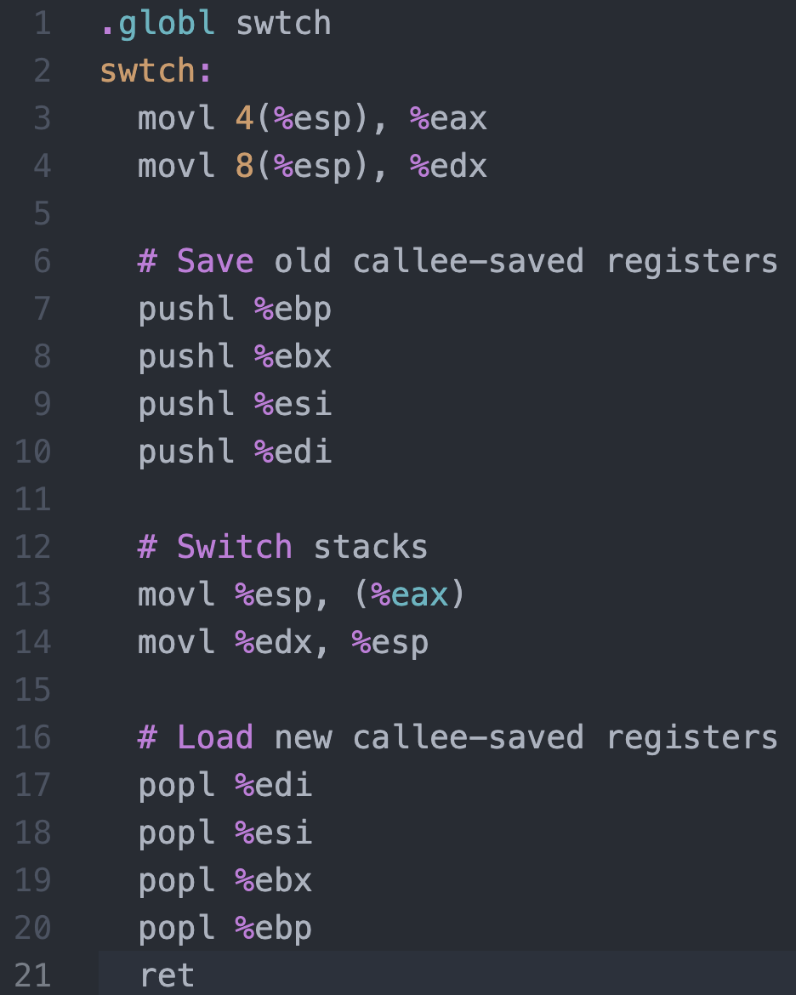
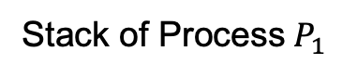
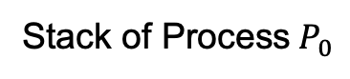
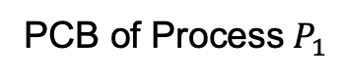
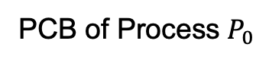
Context Switching in Xv6
%eax
%edx
context
PCB of Process${ P}_{0}$
Return address
%esp
%eip
Stack of Process${ P}_{0}$
Return address
Return address
CPU
context
PCB of Process${ P}_{1}$
Stack of Process${ P}_{1}$
Memory

Slide 21
Process Lifecycle

Slide 22
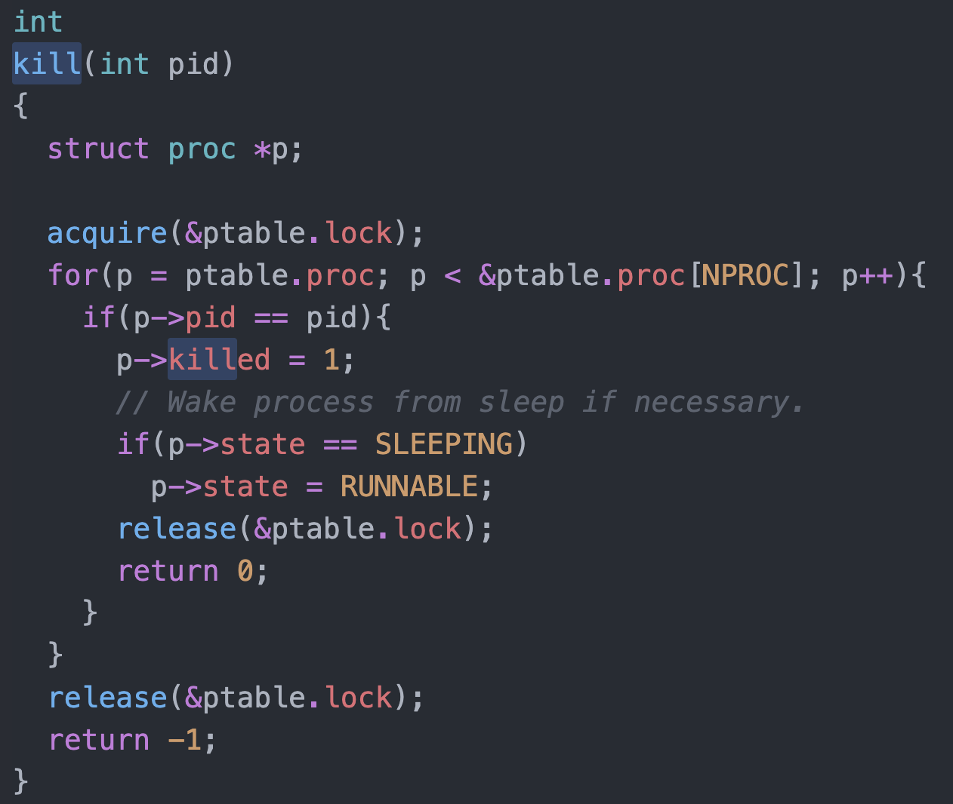
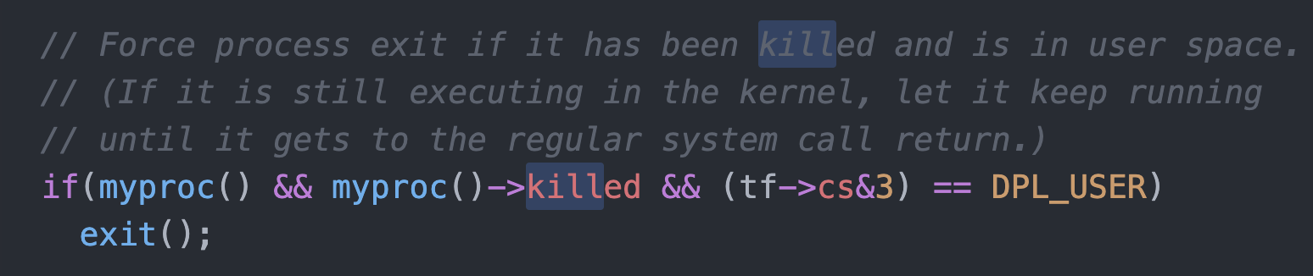
Killing a waiting process

Slide 23
Process Scheduling
Maximize CPU use, quickly switch processes onto CPU for time sharing
Process scheduler selects among available processes for next execution on CPU
Maintains scheduling queues of processes
Job queue – set of all processes in the system
Ready queue – set of all processes residing in main memory, ready and waiting to execute
Device queues – set of processes waiting for an I/O device
Processes migrate among the various queues

Slide 24
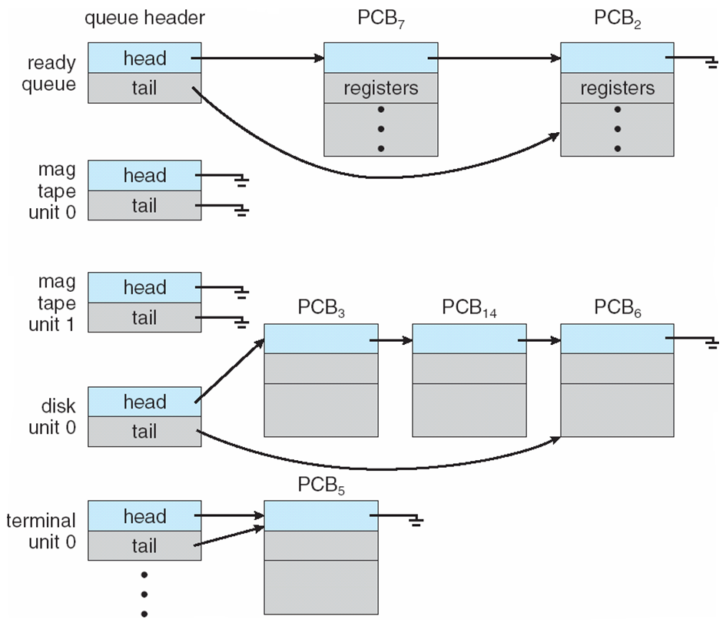
Ready Queue And Various I/O Device Queues

Slide 25
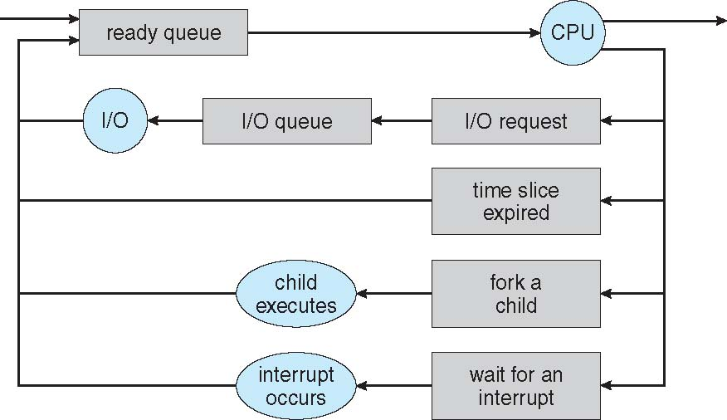
Representation of Process Scheduling
Queueing diagram represents queues, resources, flows

Slide 26
Schedulers
Short-term scheduler (or CPU scheduler) – selects which process should be executed next and allocates CPU
invoked frequently (milliseconds) ⇒ (must be fast)
Long-term scheduler (or job scheduler) – selects which processes should be brought into the ready queue
invoked infrequently (seconds, minutes) ⇒ (may be slow)
controls the degree of multiprogramming
Processes can be described as either:
I/O-bound process – spends more time doing I/O than computations, many short CPU bursts
CPU-bound process – spends more time doing computations; few very long CPU bursts
Long-term scheduler strives for good process mix

Slide 27
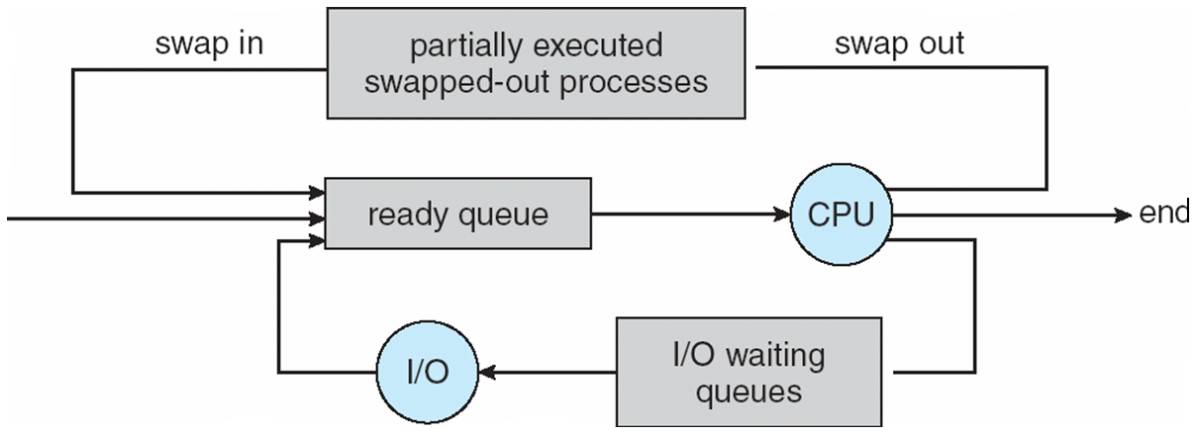
Addition of Medium Term Scheduling
Medium-term scheduler can be added if degree of multiple programming needs to decrease
Remove process from memory, store on disk, bring back in from disk to continue execution: swapping

Slide 28
Process Creation
Parent process creates children processes, which, in turn create other processes, forming a tree of processes
Generally, process identified and managed via a process identifier (pid)
Resource sharing options
Parent and children share all resources
Children share subset of parent’s resources
Parent and child share no resources
Execution options
Parent and children execute concurrently
Parent waits until children terminate

Slide 29
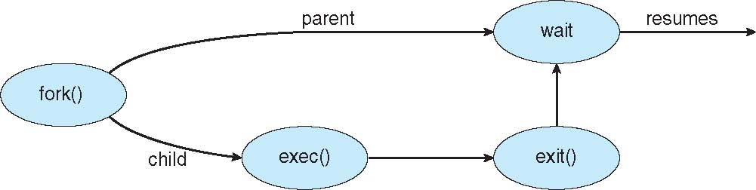
Process Creation (Cont.)
Address space
Child duplicate of parent
Child has a program loaded into it
UNIX examples
fork() system call creates new process
exec() system call used after a fork() to replace the process’ memory space with a new program

Slide 30
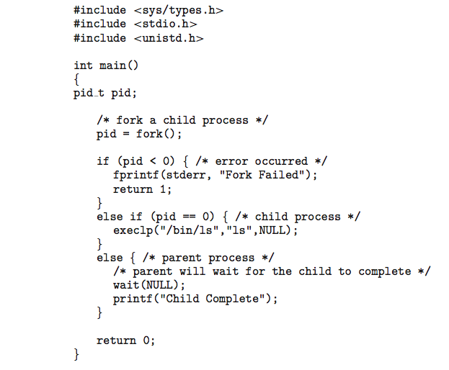
C Program Forking Separate Process

Slide 31
Process Termination
Process executes last statement and then asks the operating system to delete it using the exit() system call.
Returns status data from child to parent (via wait())
Process’ resources are deallocated by operating system
Parent may terminate the execution of children processes using the abort() system call. Some reasons for doing so:
Child has exceeded allocated resources
Task assigned to child is no longer required
The parent is exiting and the operating systems does not allow a child to continue if its parent terminates

Slide 32
Process Termination
Some operating systems do not allow a child to exist if its parent has terminated. If a process terminates, then all its children must also be terminated.
cascading termination. All children, grandchildren, etc. are terminated.
The termination is initiated by the operating system.
The parent process may wait for termination of a child process by using the wait()system call. The call returns status information and the pid of the terminated process
pid = wait(&status);
If no parent waiting (did not invoke wait()) process is a zombie
If parent terminated without invoking wait , process is an orphan

